Slide 1

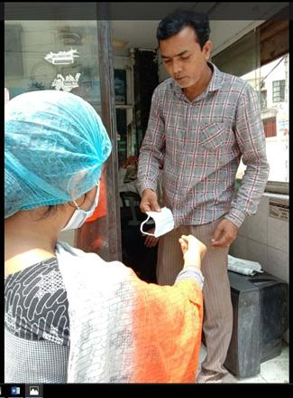

International Service Committee
28 October 2020

Slide 2
AGENDA
CHAIR: RAJBIR(ROGER) S MANN RC CAMBRIDGE – PRESTON HESPELER
ISC MEETING WEDNESDAY, OCTOBER 28 2020 6.00 – 7.30 PM
6.00 – 6.30 Introductions Chair and members
6.30 International Service Projects Chair
6.40 Resources Chair
6.45 Grants, DDF, Funding Norm Bindon DRFC
7.00 Rotary Friendship Exchange Eva Quijano RFE Ch
7.10 West Pokot Water Project Henry E. (Jim) Moore RC GuelphWellington
7.20 Closing remarks Chair, members
Next Meeting December 16,2020
International Service Committee
28 October 2020

Slide 3
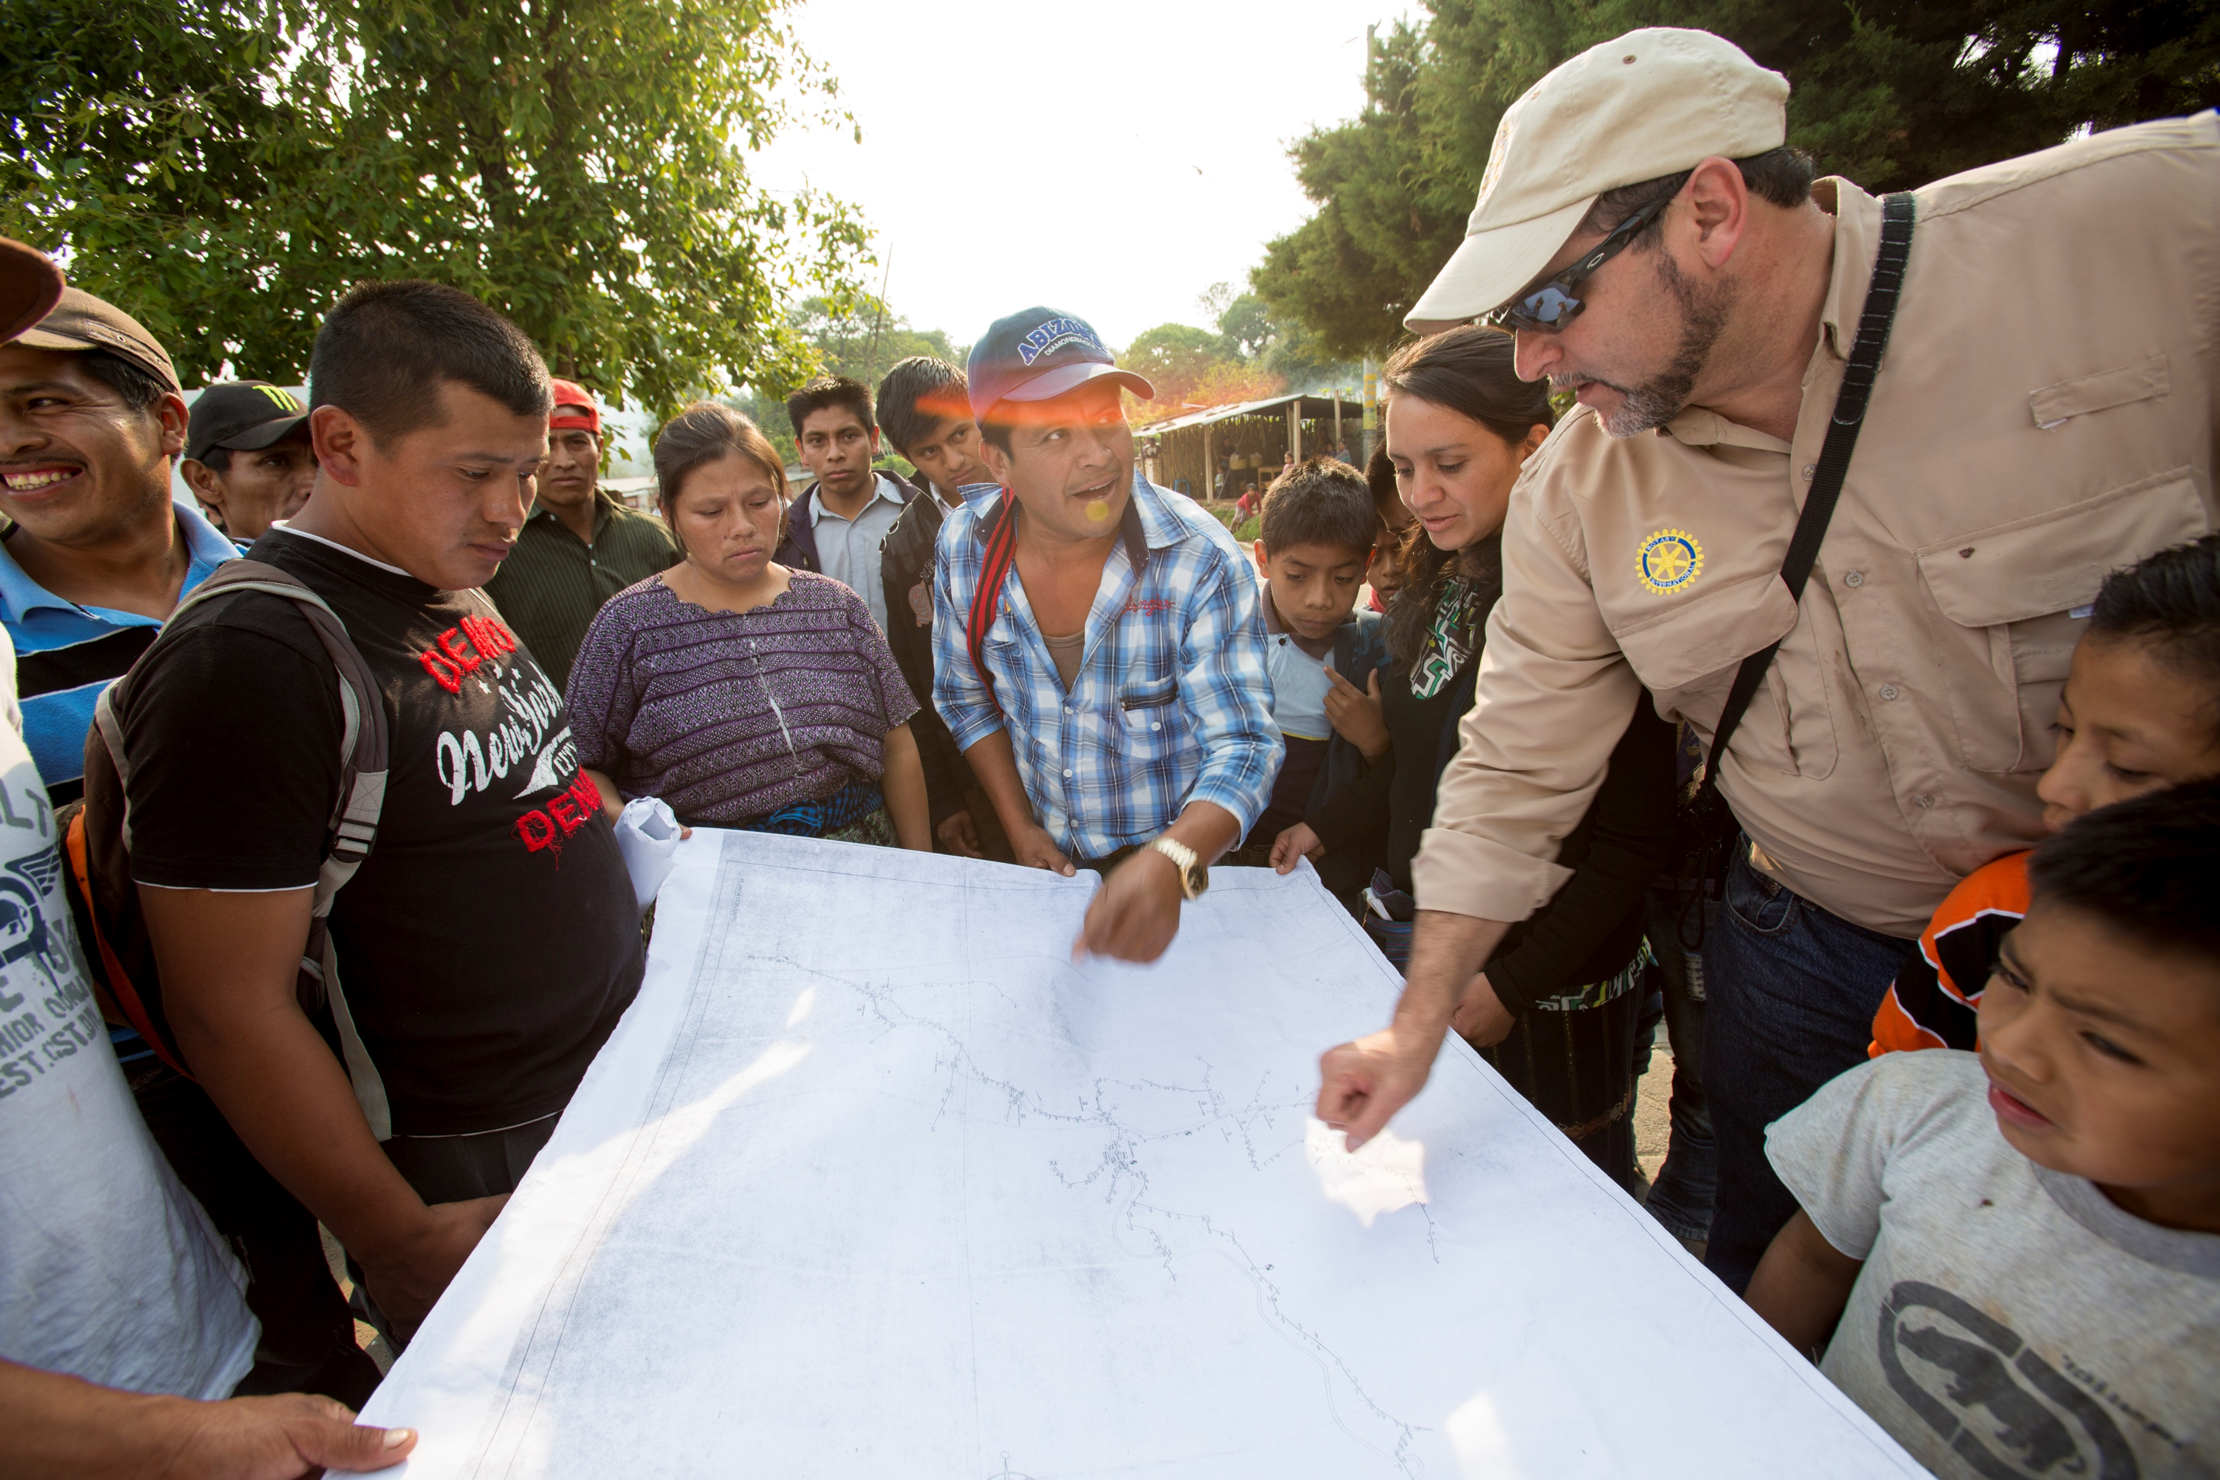
Lifecycle of a project
Planning & organizing
Acquiring resources
Implementing your project
Evaluating & promoting
International Service Committee
28 October 2020

Slide 4

Roadmap to success
Aligning a project or grant with Rotary’s areas of focus
Obtaining assistance with project design, planning, and implementation
Obtaining information about the global grant process
Conducting a community assessment
Identifying local and international partners
Securing funding
Incorporating Sustainability
Incorporating measurement and evaluation benchmarks
International Service Committee
28 October 2020

Slide 5
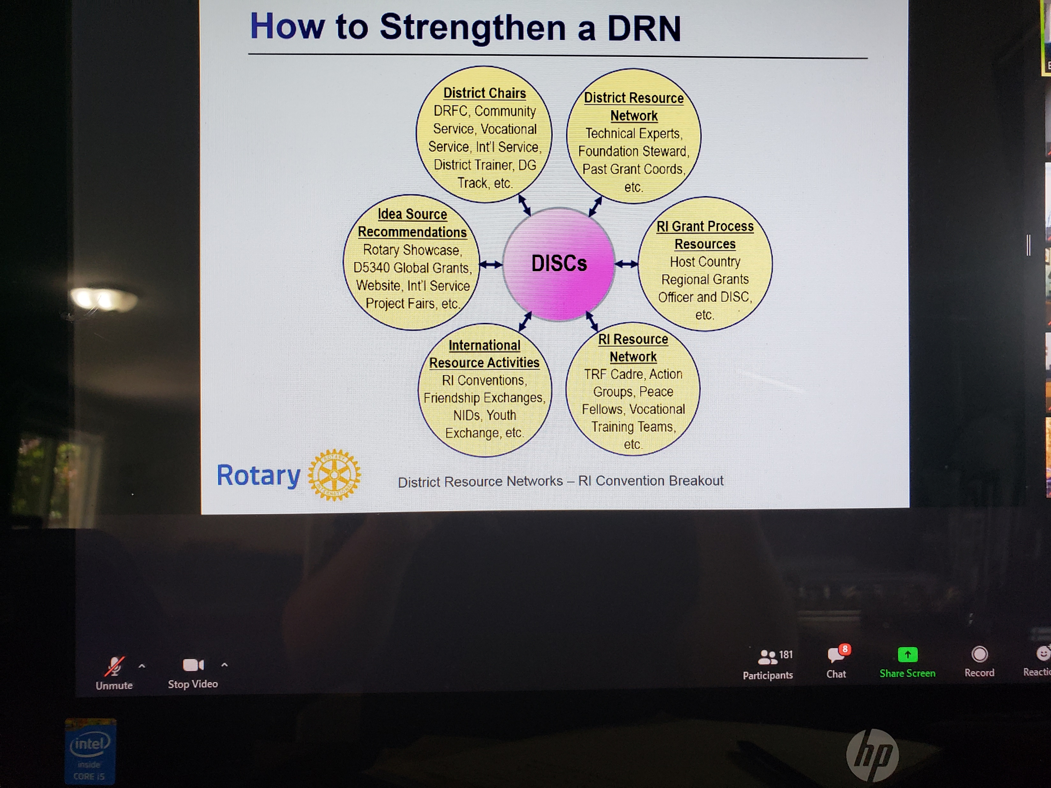

Resources
International Service Committee
28 October 2020

Slide 6


ISC Next steps
Communication
Information
Co-ordination
Resource Network
Rotary International (My Rotary)
International Service Committee
Foundation Committee
Rotary Action Groups
Regional Grants Officer
TRF Cadre
International Service Committee
28 October 2020
Next Meeting December 16,2020

